Slide 1
In built
Without Target
Principal Component Analysis
Singular Value Decomposition
With Target
Chi Square Selector
Model based selector (Random Forest and so on)
Custom built
Information Value using Weight of Evidence
Custom Transformers
Voting Based selection
PySpark Variable Selection

Slide 2
Exploratory Data Analysis
Zip | Home type | HOA fees | Sq. Ft | Price
19102 | Town Home | $100 | 2400 | $350K
19103 | Condo | $300 | 1200 | $200K
19145 | Single Family Unit | NaN | 2500 | $400K
19150 | Single Family Unit | NaN | 1800 | NaN
19040 | Town Home | $250 | 2275 | $325K

Slide 3
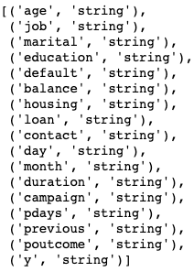
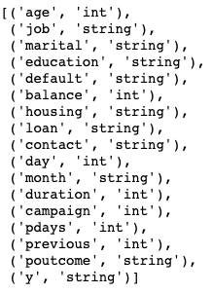
Without inferSchema
With inferSchema

Slide 4
OneHotEncoderEstimator
Education | Education_Primary | Education_Secondary | Education_Tertiary | Education_Unkown
primary | 1 | 0 | 0 | 0
secondary | 0 | 1 | 0 | 0
tertiary | 0 | 0 | 1 | 0
Unknown | 0 | 0 | 0 | 1
Primary | 1 | 0 | 0 | 0
secondary | 0 | 1 | 0 | 0

Slide 5
String Indexer
Education | Education_Index
primary | 0
secondary | 1
tertiary | 2
Unknown | 3
Primary | 0
secondary | 1

Slide 6
ChiSq selector
 |  | Survived
Gender |  | No | Yes | Total
 | Female | 81 | 231 | 312
 | Male | 468 | 109 | 577
 | Total | 549 | 340 | 889

Slide 7
Monotonic
Monotonic
Non-Monotonic

Slide 8
Spearman calculation
Mathematics (mark) | Physics (mark) | Rank for Mathematics | Rank for Physics | d_{i} | d_{i}²
48 | 56 | 7 | 7 | 0 | 0
75 | 89 | 3 | 2 | 1 | 1
53 | 65 | 6 | 6 | 0 | 0
68 | 72 | 5 | 5 | 0 | 0
92 | 74 | 1 | 4 | -3 | 9
88 | 81 | 2 | 3 | -1 | 1
74 | 99 | 4 | 1 | 3 | 9
 |  |  |  | Total | 20

Slide 9
Absolute ⍴ value | Relationship
0.00 to 0.19 | very weak
0.20 to 0.39 | weak
0.40 to 0.59 | moderate
0.60 to 0.79 | strong
0.80 to 1.0 | very strong

Slide 10
Variable Name | Random Forest | Decision Tree | Chi Square | Gradient Boosting | WOE & IV | Total Votes
Age | 1 | 1 | 1 | 0 | 1 | 4
Gender | 1 | 1 | 0 | 1 | 1 | 4
Income | 1 | 0 | 0 | 1 | 1 | 3
Education | 0 | 0 | 1 | 1 | 0 | 2
Occupation | 1 | 0 | 0 | 0 | 0 | 1
Homeowner | 0 | 0 | 0 | 0 | 0 | 0

